Slide 1
Banking System
SQL Project by
Sebastian, Joseph, Roy, Meryl

Slide 2

Project Description
Objective: to build a robust, secure, and user-friendly banking system application for managing accounts, cards, and transactions.
The database helps display to customers their personal banking data while keeping any credentials safe from any malicious attacks or injections through hashed passwords, input validation, and administrative management.
Scope of Presentation: to summarize the functionalities implemented (e.g., customer management, accounts, transactions, cards).
Significance: Highlight contributions to solving real-world banking challenges.

Slide 3

Preface
Currently Limited Functionality due to Security Bottleneck
Pentesting welcome: hack us!

Slide 4
MEET THE TEAM
Sebastian – Security: Hashing, Login (PHP), Input Validation/Sanization
Joseph – Queries, HTML (Tables, Style), PHP, DB Connection
Meryl – Normalization, Diagram
Roy – HTML, CSS
Software Used: HTML, CSS, PHP, WINSCP, MySQL, Brackets

Slide 5
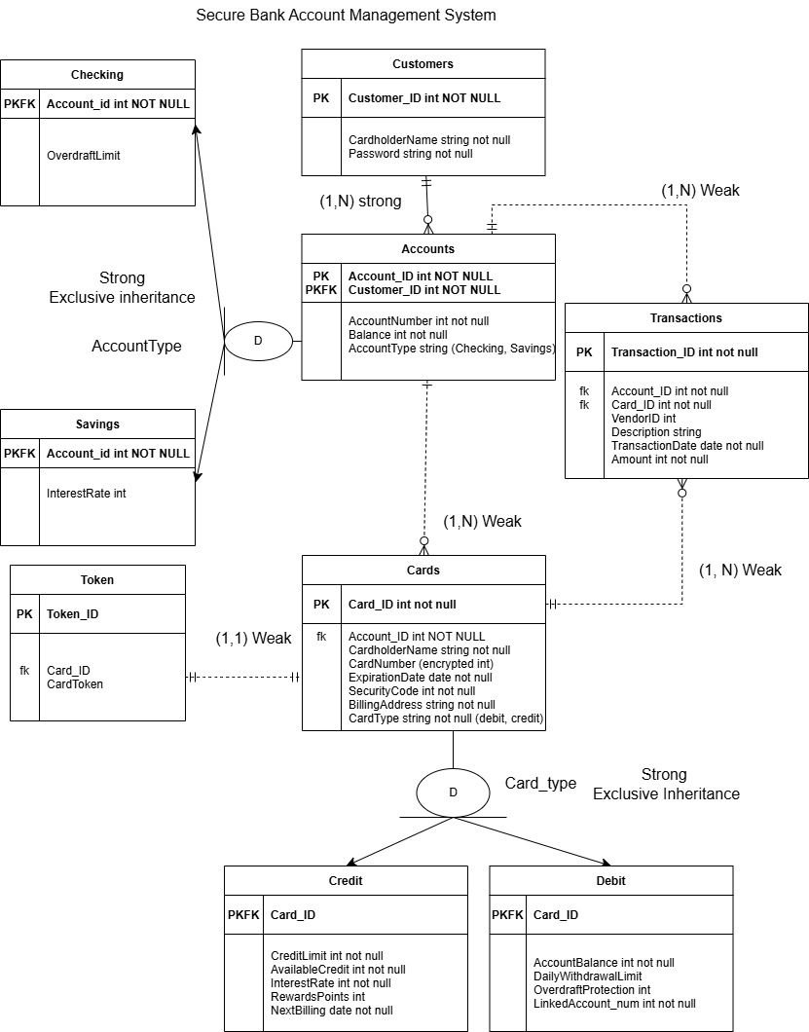
ER Diagram
Original design by Sebastian
Normalization & Edits by Meryl
tokenization has been --> implemented with hashing. There is no longer an additional Token table.

Slide 6
Normalization
By Meryl
1. Customers (customer_id (int, PK), account_id (int, PK, FK), cardholder_name (string), password (string)
Customer_id | Account_id | Cardholder_name | password
Cardholder_name and password are independent of each other but are completely dependent on the recognition of customer_id and account_id.
2. Accounts Table (account_id (int, PK), account_number (int), balance (int), account_type (string))
Account_id | account_number | balance | Account_type
Account number, balance, and account type all rely on ID without necessarily relying on each other, and have unique information that warrant being within the same table.

Slide 7
3. Checking Account Table (account_id (int, PK, FK), account_type (string, PK, FK), linked_debit_card_id (int), overdraft_limit (int))
Account_id | Account_type | Linked_debit_card_id | Overdraft_limit
As a subtype of Accounts, this table has linked debit card and overdraft limits relying upon account type, which is therefore made into a primary key alongside account id.
4. Savings Account Table
(account_id (int, PK FK), account_type (string, PK, FK), interest_rate (int))
Account_id | Account_type | Interest_rate
Same reasoning as Checking Account.
5. Cards Table
(card_id (int, PK), account_id (int, PK, FK), cardholder_name (string), card_number (encrypted int), expiration_date (date), security_code (int), billing_address (string), card_type (string)
Card_id | Account_id | Cardholder_ name | Card_ number | Expiration_date | Security_code | Biling_ address | Card_type
All attributes listed are dependent on card_id and account_id.

Slide 8
6. Credit Card Table
(card_id (int, PK), card_type (string, PK, FK), credit_limit (int), available_credit (int, interest_rate (int), reward_points (int), next_billing_date (date)
Card_id | Card_type | Credit_limit | Available_credit | Interest_rate | Reward_points | Next_biling_date
As a subtype of Cards, the attributes depended on a specific answer of Card Type, which was thus split into the credit and debit subtypes to house all the depended attributes.
7. Debit Card Table
(card_id (int, PK), card_type (string, PK, FK), account_balance (int), daily_withdrawal_limit (int), overdraft_protection (int), linked_account_num (int))
Card_id | Card_type | Account_balance | Daily_withdrawal_limit | Overdraft_protection | Linked_account_num
Same reasoning as Credit Cards table.

Slide 9

8. Transactions Table
(transaction_id (int, PK), card_id (int, PK, FK), account_id (int, FK), vendor_id (int), description (string), transaction_date (date), amount (int))
Transaction_id | Card_id | Account_id | Vendor_id | description | Transaction_date | amount
Transaction mitigates dependency of included attributes, which would have caused issues if included in the Card and Account tables. Transactions table therefore maintains 3NF.
9. Token Table
(token_id (int, PK), card_id (int, FK), card_token (string))
Token_id | Card_id | Card_token
Since Token is dependent on card_id, the Token_id was separated from Card as a response.

Slide 10
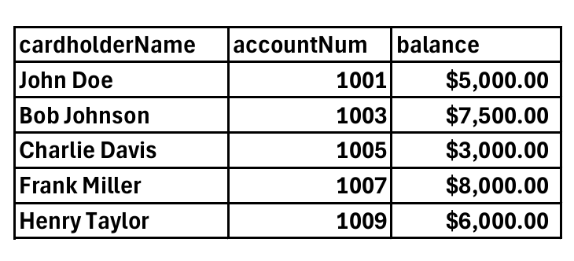
SQL Queries
By Joseph
1.Customer Credit Card Information:
Retrieves cardholder name, account number, and balance for credit card holders
Demonstrates ability to join multiple tables (Customers, Accounts, Cards) and filter results
SQL code:
SELECT Customers.cardholderName,Accounts.accountNum, Accounts.balance
FROM Customers
INNER JOIN Accounts ON Customers.customerID = Accounts.customerID
INNER JOIN Cards ON Accounts.accountID = Cards.accountID
WHERE Cards.cardType = 'Credit';

Slide 11
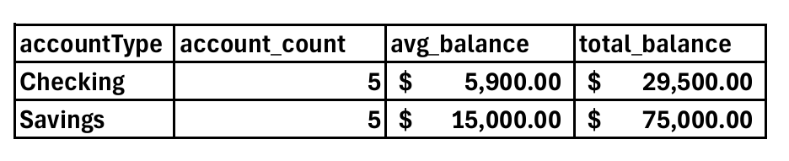
SQL Queries
2. Account Type Analysis:
Calculates account count, average balance, and total balance for each account type
Shows proficiency in using aggregate functions (COUNT, AVG, SUM) and grouping data
SQL code:
SELECT Accounts.accountType, COUNT(*) AS account_count,
AVG(Accounts.balance) AS avg_balance,
SUM(Accounts.balance) AS total_balance
FROM Accounts
GROUP BY Accounts.accountType;

Slide 12
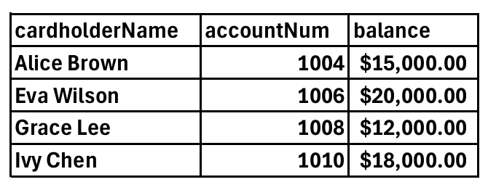
SQL Queries
3. Above-Average Balance Identification:
Finds customers with balances higher than the average for their account type
Illustrates use of subqueries and comparison operations
SQL code:
SELECT Customers.cardholderName, Accounts.accountNum, Accounts.balance
FROM Customers
INNER JOIN Accounts ON Customers.customerID = Accounts.customerID
WHERE Accounts.balance > (SELECT AVG(balance) FROM Accounts);

Slide 13
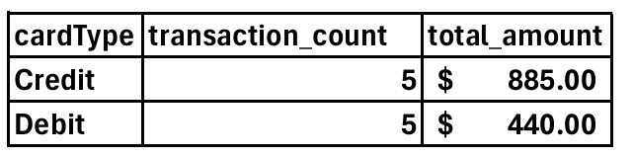
SQL Queries
4. Transaction Analysis by Card Type:
Counts transactions and sums amounts for each card type, with specific criteria
Showcases advanced SQL techniques like GROUP BY, HAVING, and complex conditions
SQL code:
SELECT Cards.cardType, COUNT(*) AS transaction_count, SUM(Transactions.amount) AS total_amount
FROM Cards
INNER JOIN Transactions ON Cards.cardID = Transactions.cardID
GROUP BY Cards.cardType
HAVING COUNT(*) > 2 AND SUM(Transactions.amount) > 200

Slide 14
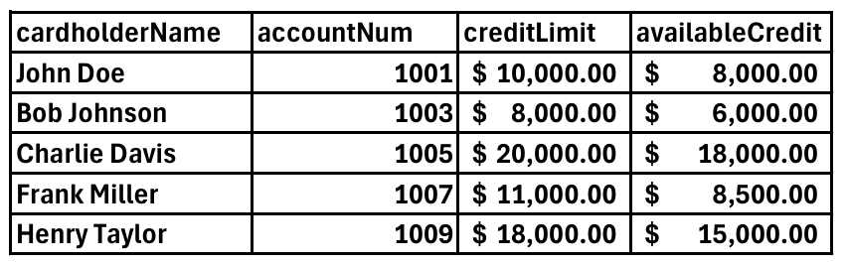
SQL Queries
5. Credit Utilization Overview:
Retrieves credit card limits and available credit for all customers
Demonstrates mastery of LEFT OUTER JOINs to include customers without credit cards
SQL code:
SELECT Customers.cardholderName, Accounts.accountNum, CreditCards.creditLimit, CreditCards.availableCredit
FROM Customers
LEFT OUTER JOIN Accounts ON Customers.customerID = Accounts.customerID
LEFT OUTER JOIN Cards ON Accounts.accountID = Cards.accountID
LEFT OUTER JOIN CreditCards ON Cards.cardID = CreditCards.cardID
WHERE Cards.cardType = 'Credit' OR Cards.cardType IS NULL;

Slide 15
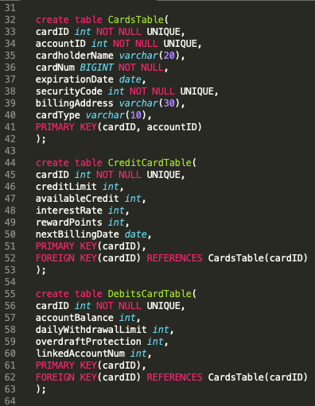
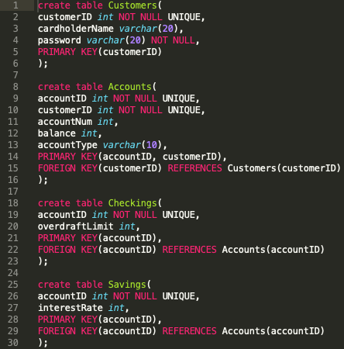
Table Creation
By Meryl

Slide 16
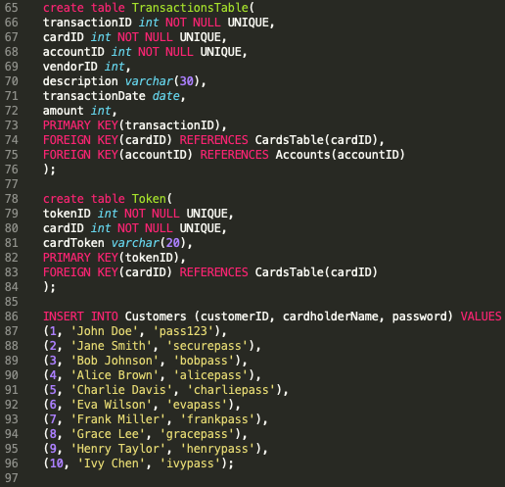
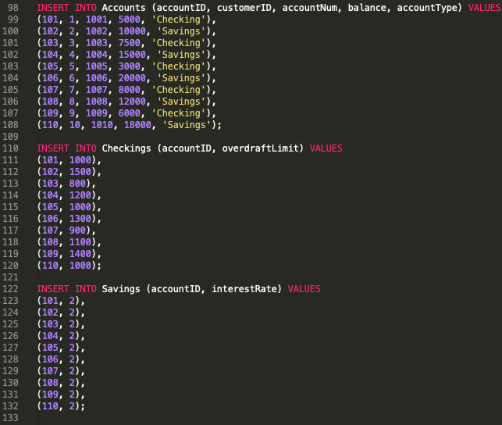

Slide 17
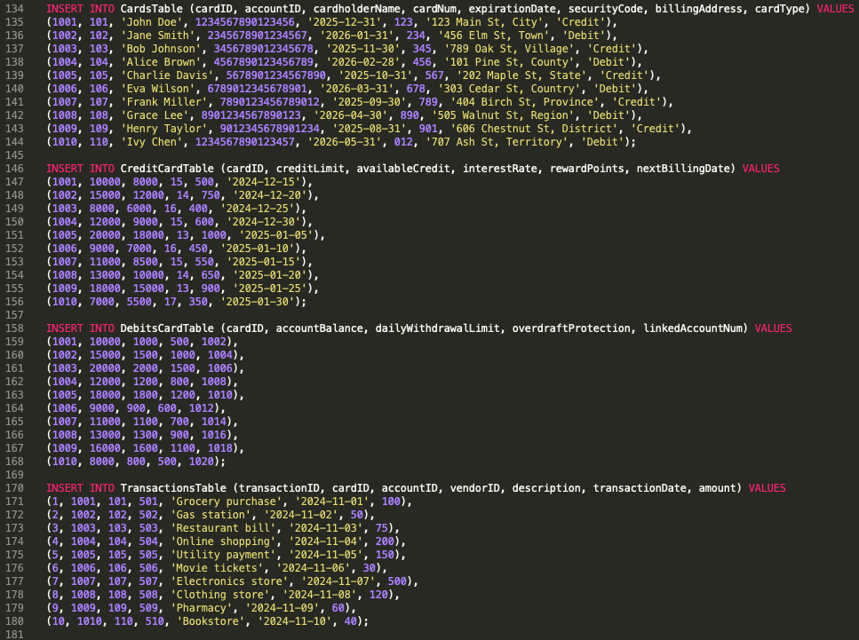

Slide 18
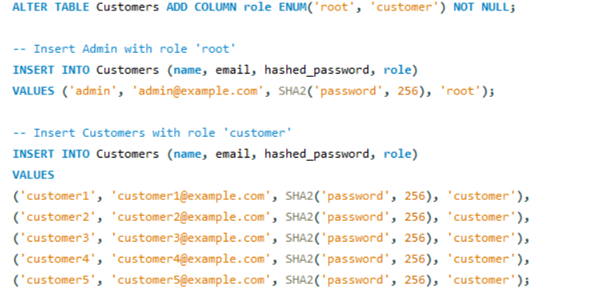
Security Modifications to tables – Sebastian
(Similar modifications to be made to credit card tables)
Vulnerability: Weak encryption.

Slide 19
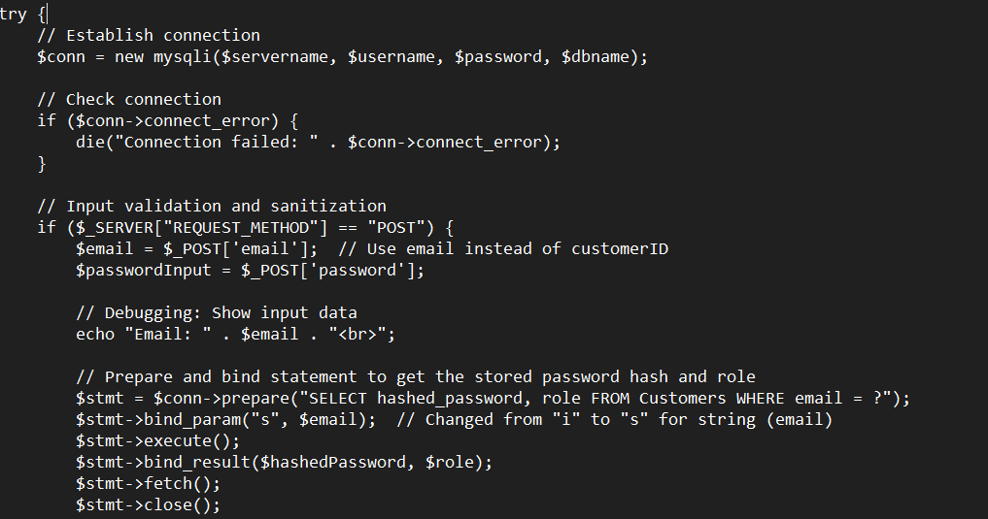
Backend of login System – Sebastian

Slide 20
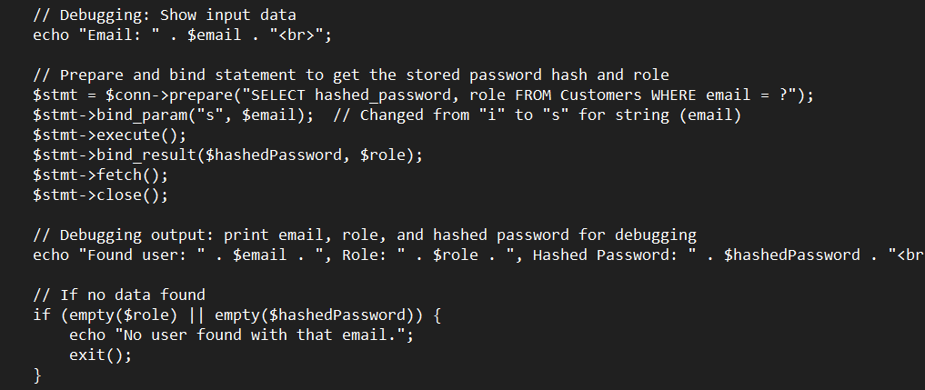
Backend of login System – Sebastian

Slide 21
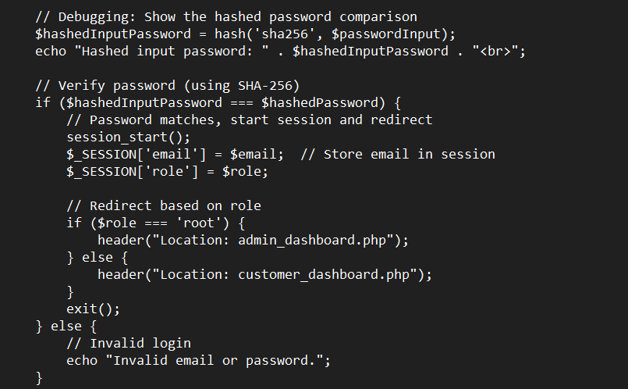
Backend of login System – Sebastian

Slide 22
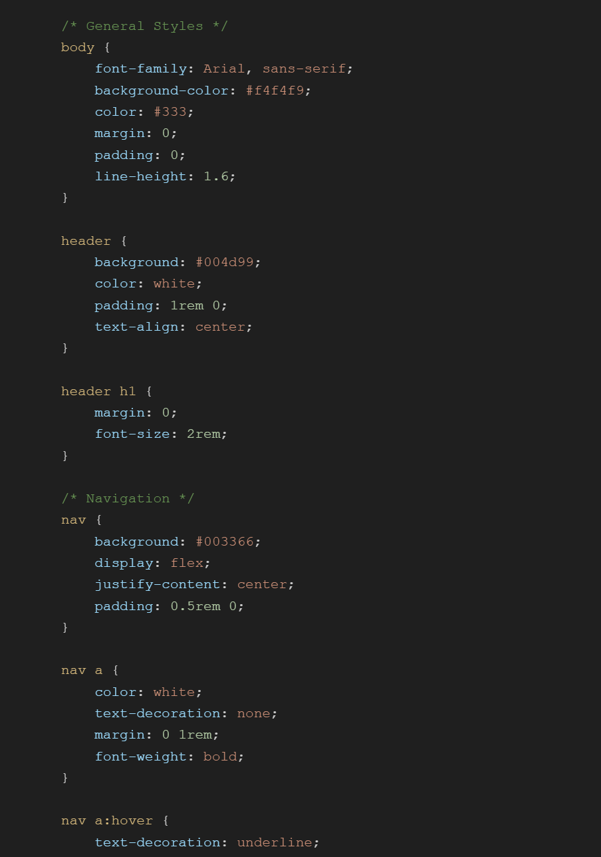
Frontend – Roy
CSS Stylesheet
Click Here for full Stylesheet
Additional style in index.html

Slide 23
Challenges, Techniques Used
Challenges:
Technical hurdles (e.g., SQL complexity, difficulties connecting to database, debugging schema issues).
Finding team coordination under time constraints.
Cryptographic dependencies
Security Bottleneck and Version Control
Techniques:
Valuable techniques for SQL language and HTML/PHP usage.
Working together as a team, and creating time to check on our project’s progress.
Understanding of database design principles within limiting constraints of scope.

Slide 24
Final Desired Edits (in order of priority)
1. Ad-Hoc Queries, Tables, and Table Pages Adjusted for Cryptographic dependencies
2. Stronger implementation of Customer and Admin Dashboard
3. Data Masking for sensitive information
“****4481930529”
4. More secure encryption (with key, somehow asymmetric if time permits)
5. Reach: HTTPS Encryption for all web requests with SSL certificate, to prevent on-path attacks

Slide 25

Project Outcomes
Success implementing banking database.
Creation of normalized tables
Development of complex SQL queries to extract meaningful data
Implementation of extra functionality security features (password usage, hashing)
Overall, an honest attempt of understanding real-world banking data management

Slide 26


Thank you for listening
Any questions?
Q&A

